Slide 1



British Airways data science programme
Web scraping to gain company insights
github.com/luis-cj
linkedin.com/in/luis-cj

Slide 2
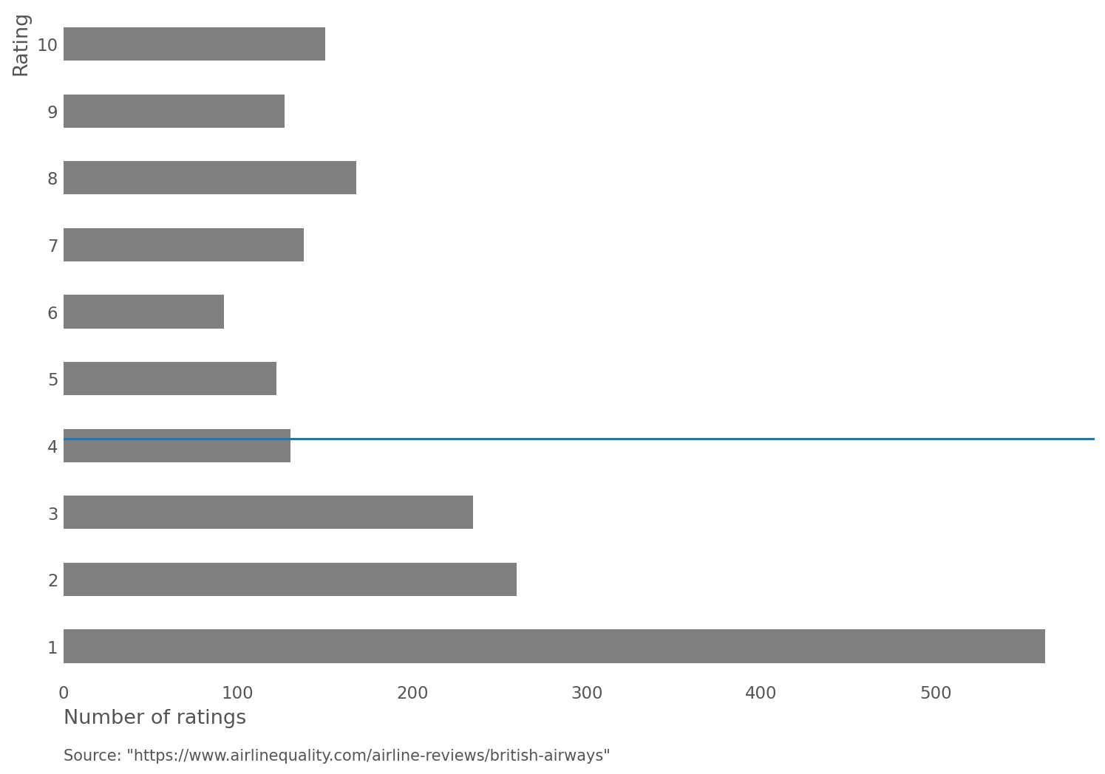
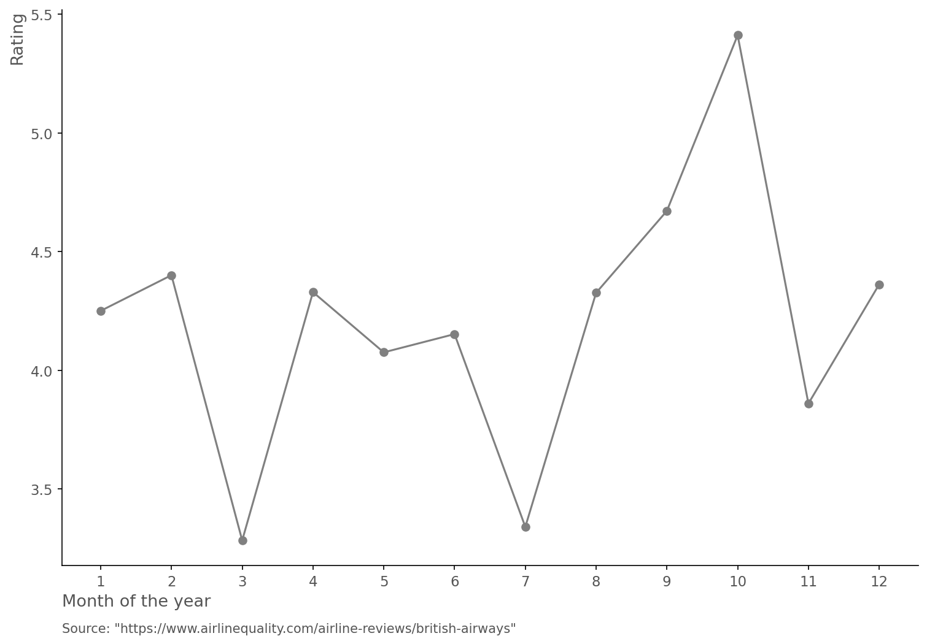
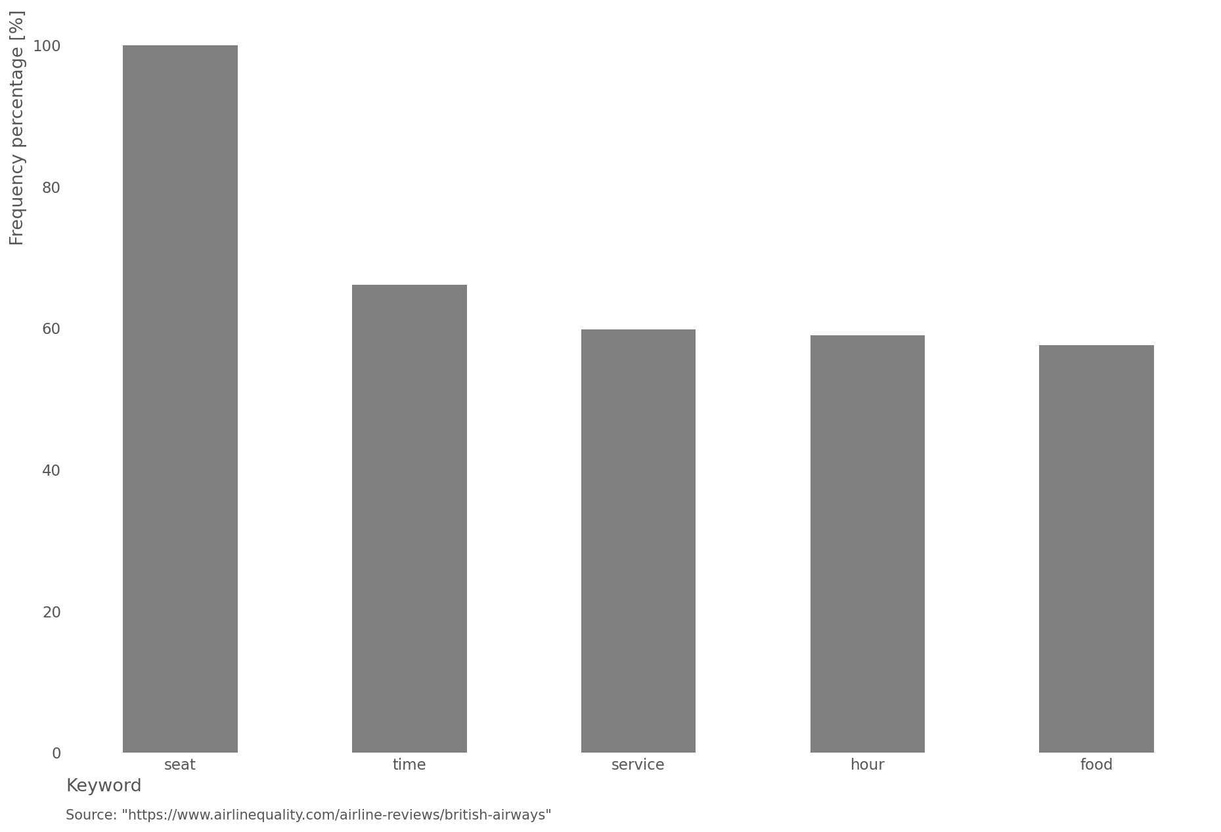
Exhibit 1: For the last 5 years, the mean rating has been 4.2/10
Exhibit 2: During the last 5 years the worst ratings have been obtained during the months of March, July and November
Mean rating: 4.2
Exhibit 3: For the worst ratings the most frequently repeated words are related to the seat on the plane, the punctuality of the flight and the in-flight services
Special attention should be payed during these months in order to increase customer satisfaction.
The worst ratings seem to accumulate during high-demand flight periods, where customers value punctuality the most. In order to increase customer satisfaction, if punctuality cannot be accomplished due to external factors, a better service should be provided to customers (e.g. free food or seat selection).

